Slide 1

Web/Python Programming
웹/파이썬 프로그래밍

Slide 2
Today
Object-oriented Programming
Object (= Instance, or object – mother of all classes in Python)
Class (= Type)
Method (= Member Function)
Inheritance

Slide 3

Types
Integer
Float
String
Boolean
Type is a class
How to make your own type
List
Set
Tuple
Dictionary

Slide 4
Object and variable
Every location in the computer’s memory has a memory address
Object: a value (or thing) at a memory address with a type
26.0 id1 float
Variable contains the memory address of the object
id1: float
degrees_celsius
id1
26.0
degrees_celsius
Notes:
객체: 파이썬에서 사용되는 모든 것
A=3 이라 하면, 3이라는 값을 가지는 정수형 객체가 자동으로 메모리에 생성된다. A는 변수 이름이며, 3이라는 정수형 객체가 저장된 메모리 위치를 가리킨다.
26.0이라는 객체의 주소값을 degrees_celsius 객체에 저장

Slide 5
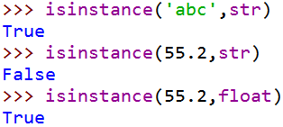
Function isinstance
Function isinstance reports whether an object is an instance of a class – whether an object has a particular type:
‘abc’ is an instance of str, but 55.2 is not.
55.2 is an instance of float.
Notes:
Isinstance 기억해놓기.
객체의 타입 확인

Slide 6
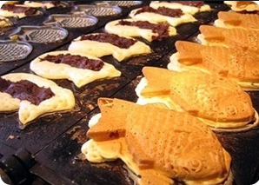
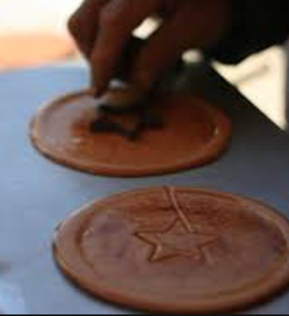

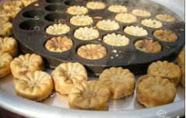
What is Class?
https://en.wikipedia.org/wiki/Class_(computer_programming)

Slide 7


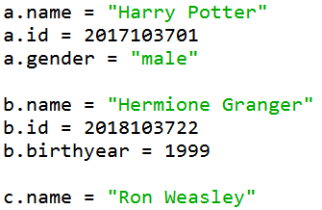
Class Student
student.py
Student is a class.
a, b, and c are the instances of the class Student.
name, id, gender, birthyear are instance variables.
a = Student() creates a Student object and then assigns that object to variable a.

Slide 8
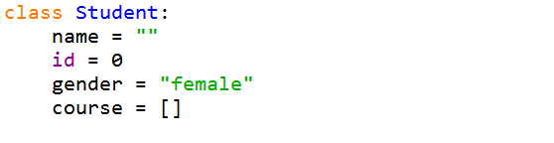



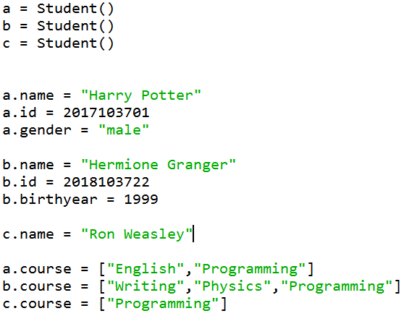

Method
Notes:
Self???? Python이 알아서 만들어서 입력으로 전달한다.
a.num_courses()라고 하면 주인공이 a이기 때문에 a를 self로 가져간다.
단 self라는 단어를 쓰는걸 잊어서는 안된다.

Slide 9
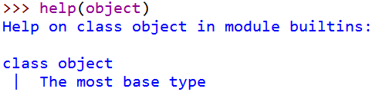


Inheritance
‘abc’ is an instance of class str
55.2 is an instance of class float
‘abc’ and 55.2 are instances of class object
Classes and functions are instances of object
Every class in Python is derived from class object, so every instance of every class is an object.
Class object is the superclass of class str, and class str is a subclass of class object.
Notes:
모든 class의 아버지 = object

Slide 10
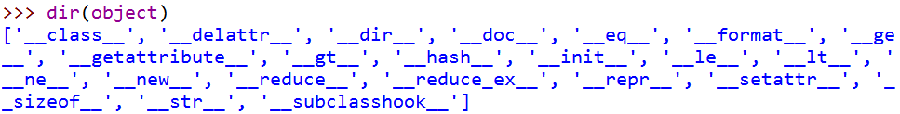
Inheritance
dir shows a list of attributes (attributes are variables inside a class that refer to methods, functions, variables, or other classes)
Every class in Python inherits these attributes from class object: they are automatically part of every class.
Every subclass inherits the features of its superclass.
It helps avoid a lot of duplicate code and makes interactions between related types consistent.

Slide 11


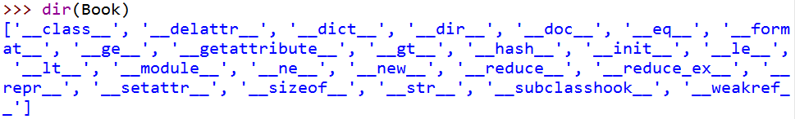
Inheritance
‘__dict__’, ‘__module__’, ‘__qualname__’, ‘__weakref__’

Slide 12
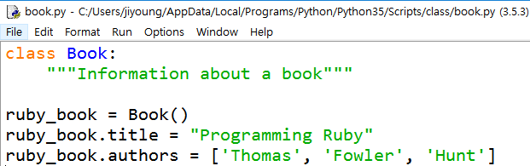
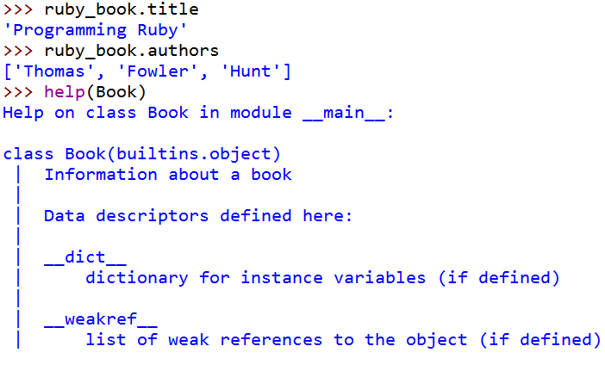
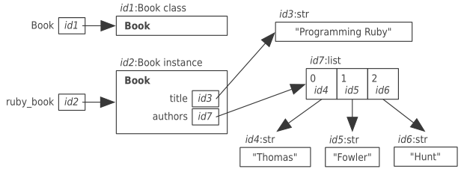
Book class

Slide 13
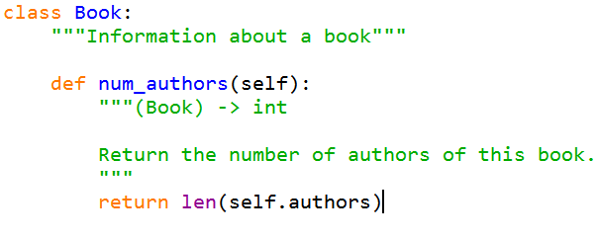


Book class - method
book is the imported module
In that module, there is class Book
Inside Book, there is method num_authors.
The argument to the call, ruby_book, is passed to parameter self.

Slide 14
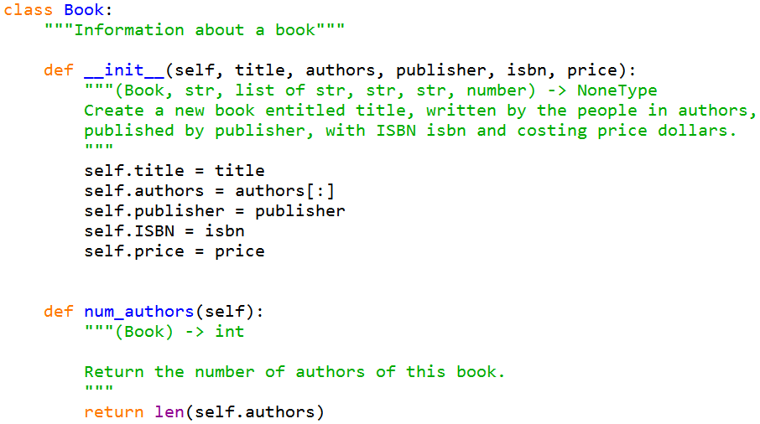
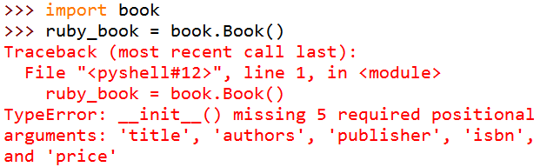

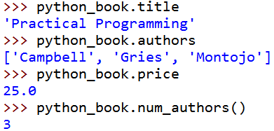
__init__ method
Notes:
We don’t want to type those extra assignment statements every time we create a Book.
__init__ = cpp의 생성자 역할
__init__는 반드시 만들어줘야 한다.
아무런 정보가 필요가 없다면 __init__이 필요가 없다.

Slide 15
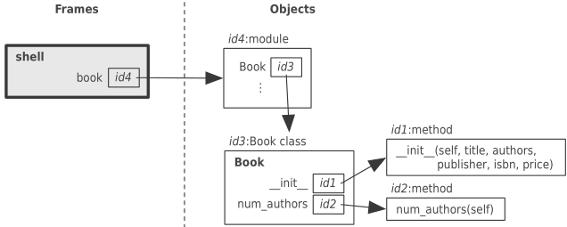
Constructor
The module book contains a single statement: the class definition.
Method __init__ is called whenever a Book object is created, to initialize the new object. (=a constructor)
Notes:
When Python executes this module, it creates a class object and assigns it to variable Book:

Slide 16
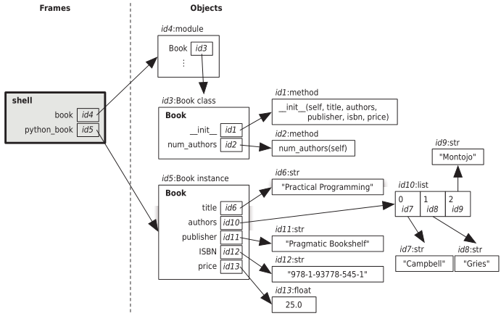
Constructor
The steps that Python follows when creating an object:
It creates an object at a particular memory address.
It calls method __init__, passing in the new object into the parameter self.
It produces that object’s memory address.
book.py

Slide 17
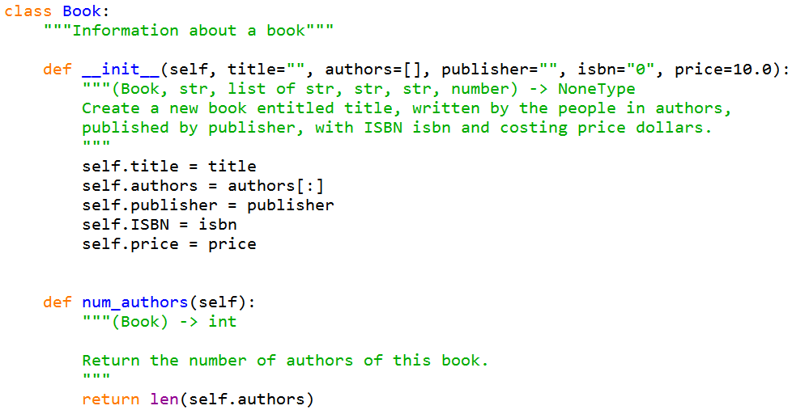
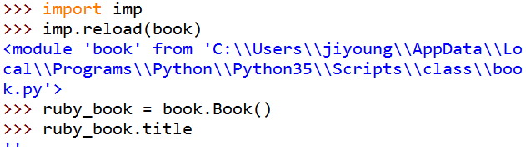
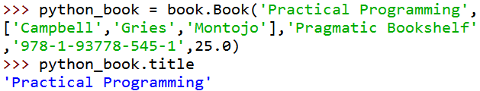
__init__ method - refined

Slide 18
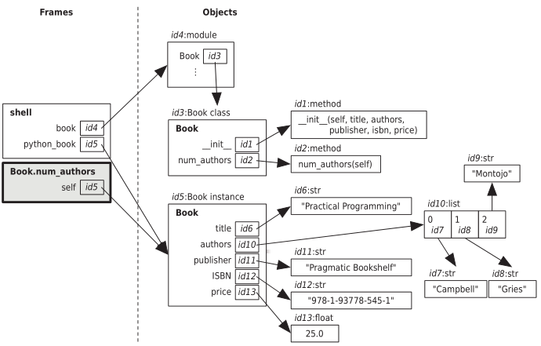
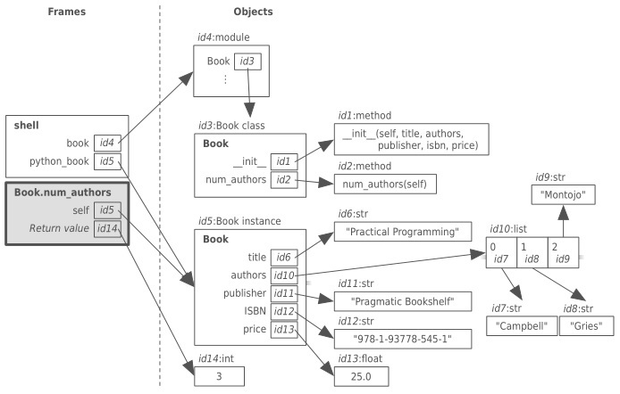
Calling a method

Slide 19
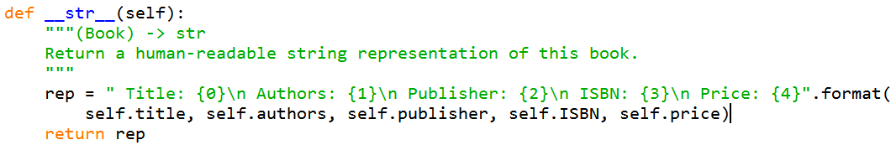
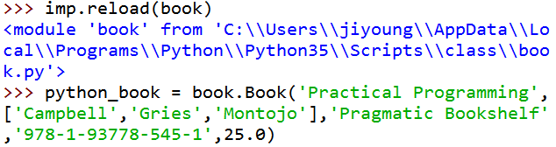
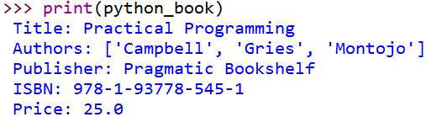
__str__ method

Slide 20
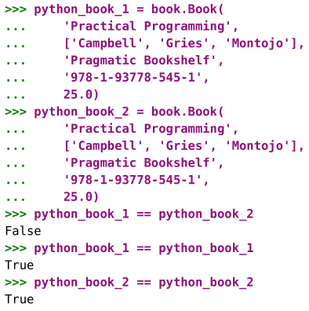
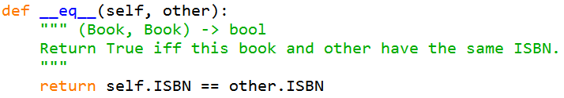
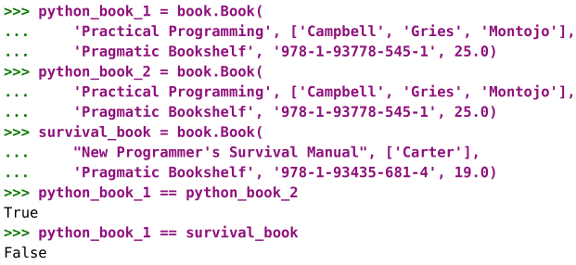
__eq__ method
Notes:
비교코드

Slide 21
Override vs. overload
We can override an inherited method by defining a new version in our subclass. This replaces the inherited method so that it is no longer used.
Overloading occurs when two or more methods in one class have the same method name but different parameters.

Slide 22
Lookup rules for a method call
Look in the current object’s class. If we find a method with the right name, use it.
If we didn’t find it, look in the superclass. Continue up the class hierarchy until the method is found.

Slide 23
Classes and objects
Classes and objects are two of programming’s power tools!
They let good programmers do a lot in very little time.
But with them, bad programmers can create a real mess…
Some concepts that will help you design reliable, reusable object-oriented software.

Slide 24
Inheritance (상속)
Whenever you create a class, you are using inheritance: your new class automatically inherits all of the attributes of class object.
Just like a child inherits attributes from his/her parents.
You can also declare that your new class is a subclass of some other class.
Managing people at a university.

Slide 25
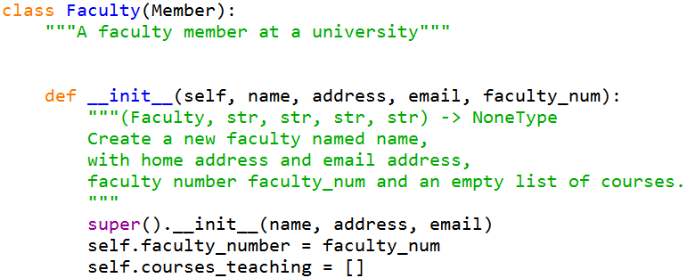
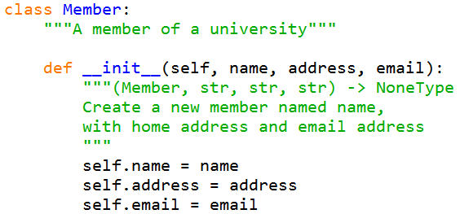
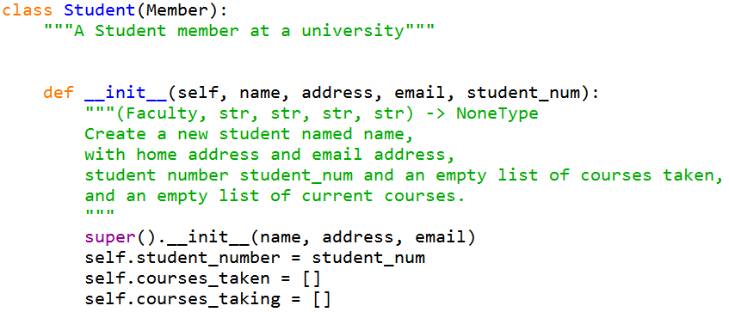
Inheritance: example
Member
Faculty
Student

Slide 26
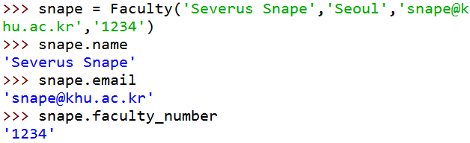
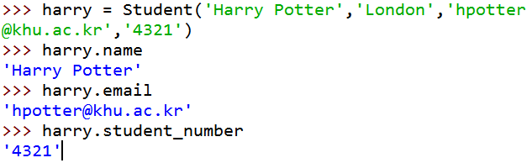
Faculty and Student

Slide 27
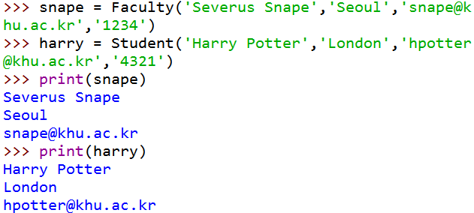
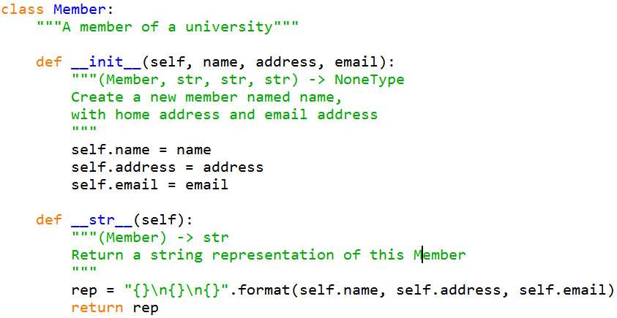
Add features to the superclass

Slide 28
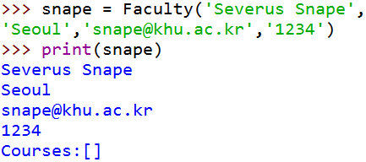
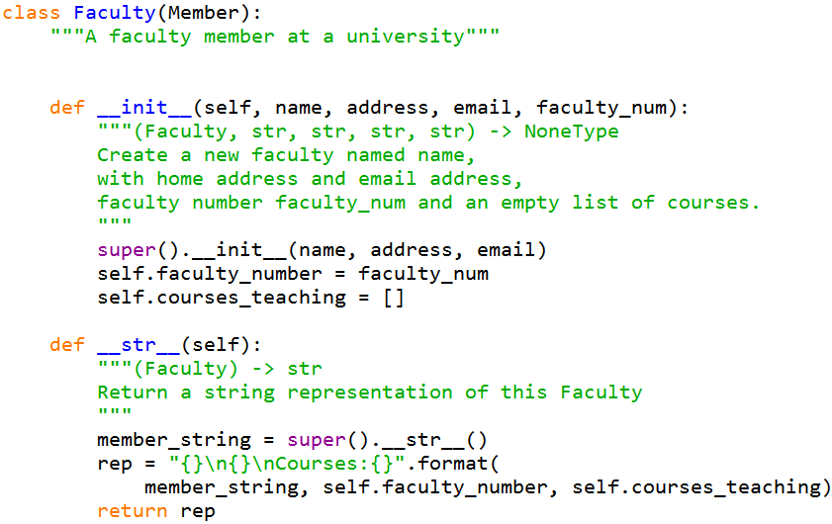
Add features to the subclass

